Slide 1
WINTER Price Setting Strategy
Big Mountain Resort

Slide 2

NOW
Only $81 ??
Good or bad ??
High or low ??

Slide 3

FUTURE
$95 !!
Do not surprise It is fair
What we have == What we charge

Slide 4
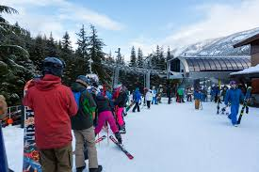
—Marketplace Data says
“People value some facilities more than others and willing to pay more !!”

Slide 5
What People Value most:
FastQuads
Number of fast four person chairs
Runs
Snow Making_ac
Count of the number of runs on the resort
Total area covered by snow making machines in acres
Vertical Drop
Vertical change in elevation from the summit to the base in feet

Slide 6
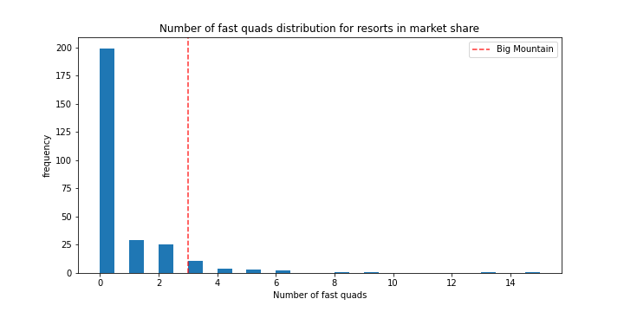
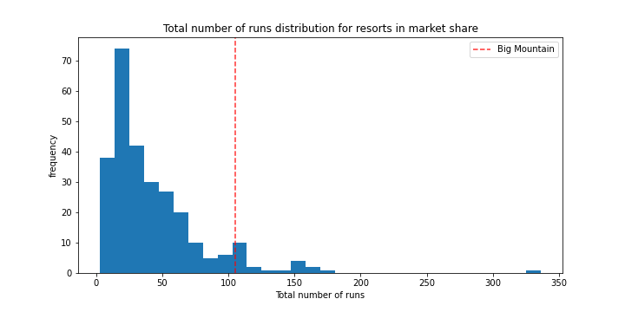
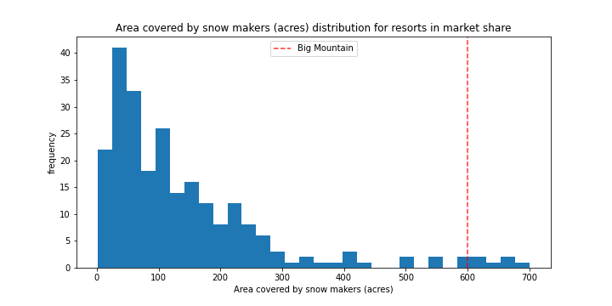
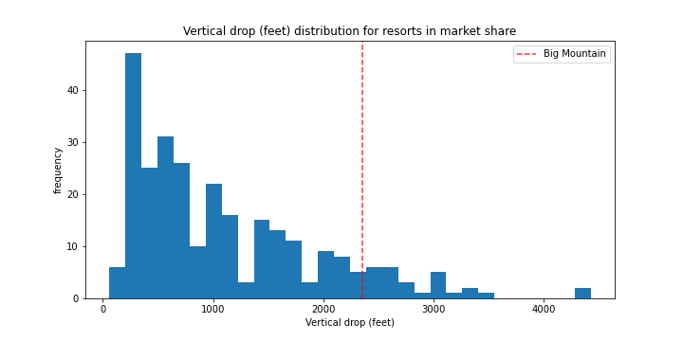
Where we at:
FastQuads
Runs
Snow Making_ac
Vertical Drop

Slide 7
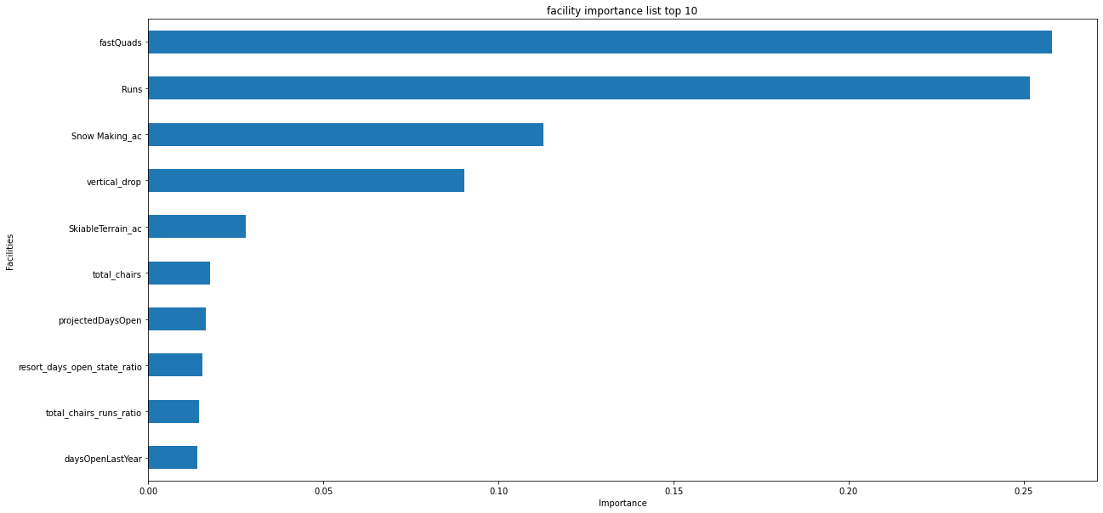
How important:

Slide 8
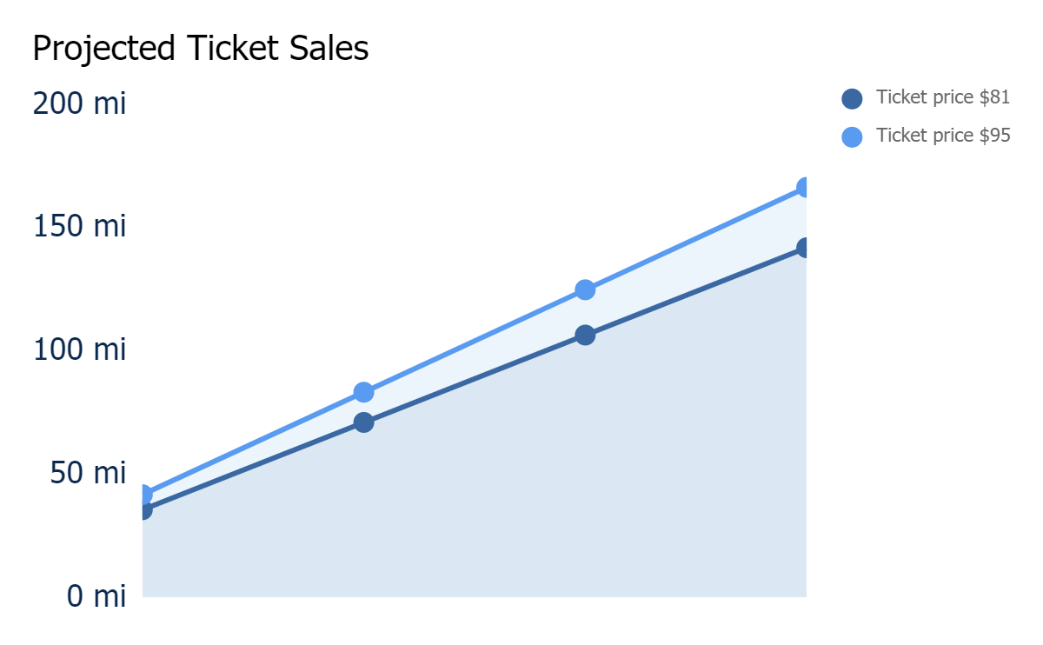
Predicted Results
$24,500,000+
In ticket sales
+17%
Increase on revenue
Before
After
15.9
Covers of lift installed
based on 350,000 visitors and 5 days per visit

Slide 9
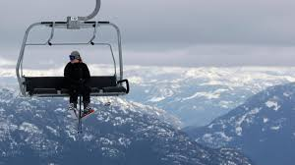
Summary
Suggested price $95
Projected $24,500,000 increase on sales
Based on the facilities on hand and position in market
Limitation: data scope

